Slide 1

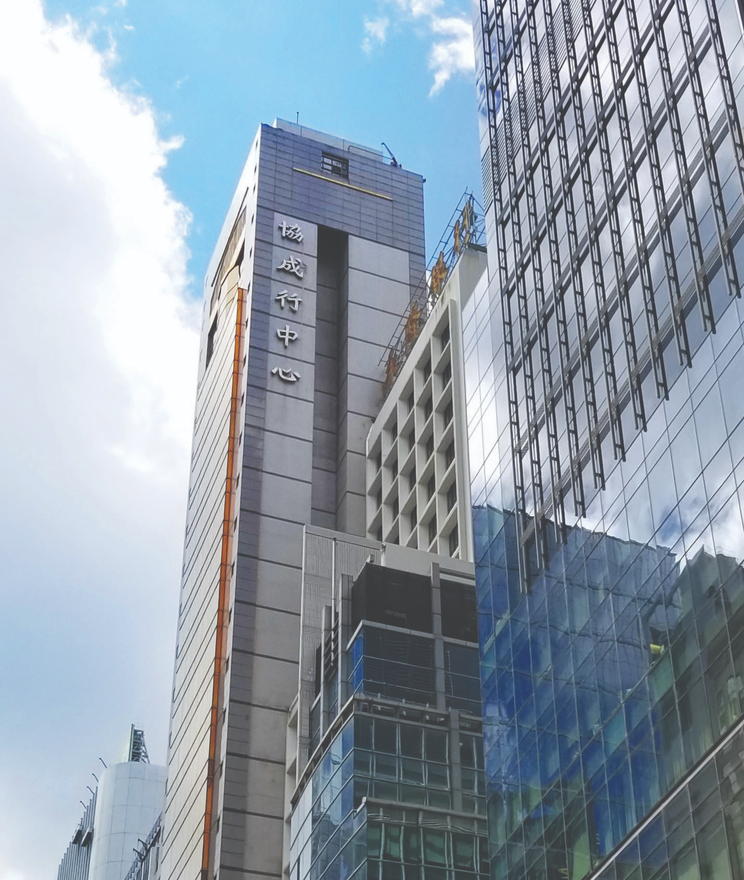



HIP SHING HONG XHS Performance Report - Aug. 2026
6 September 2026

Slide 2
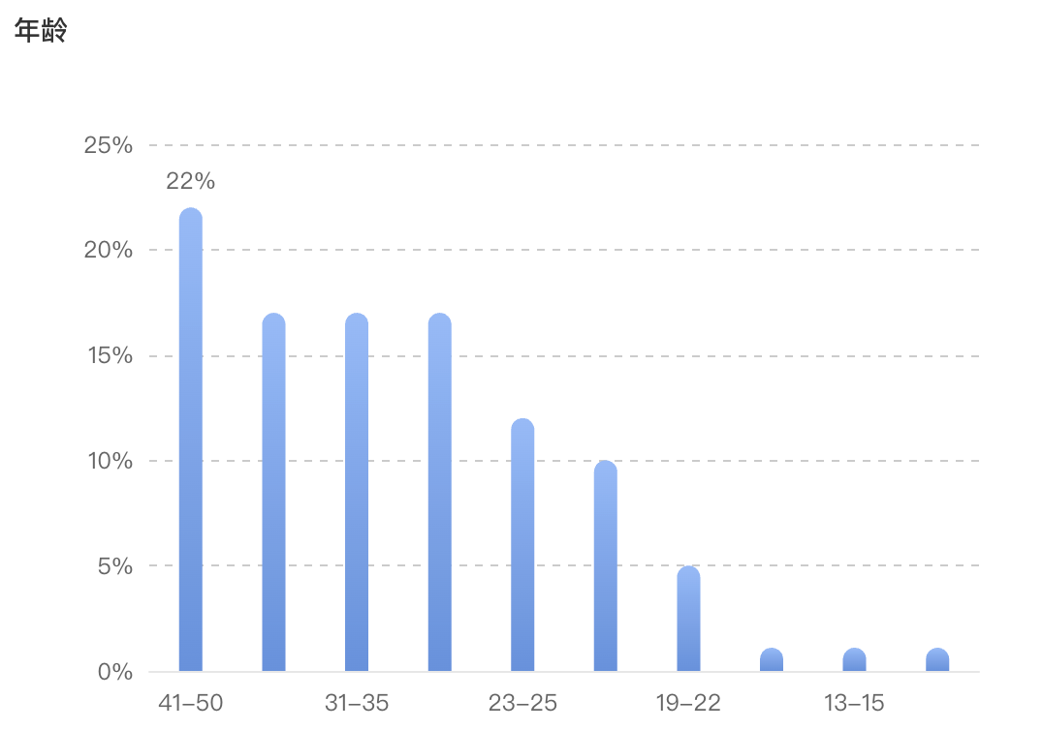
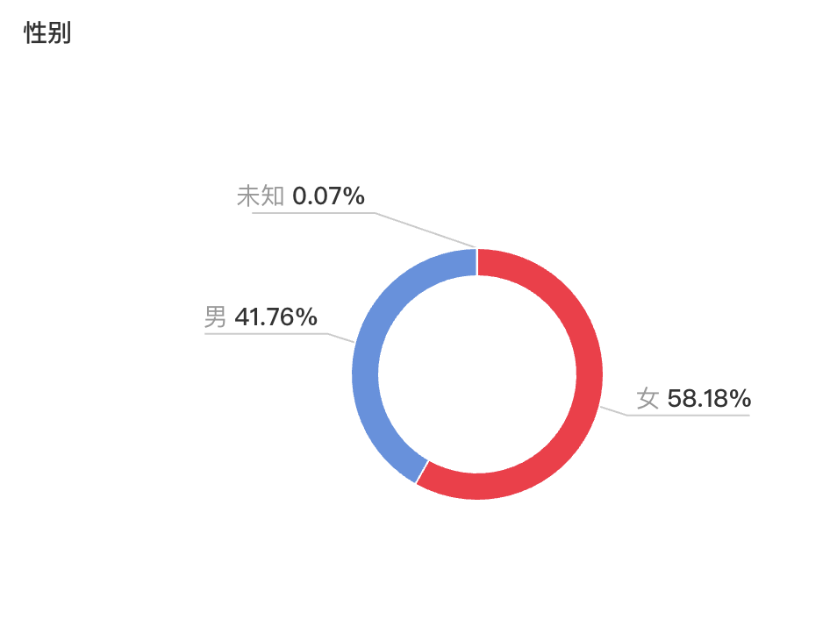
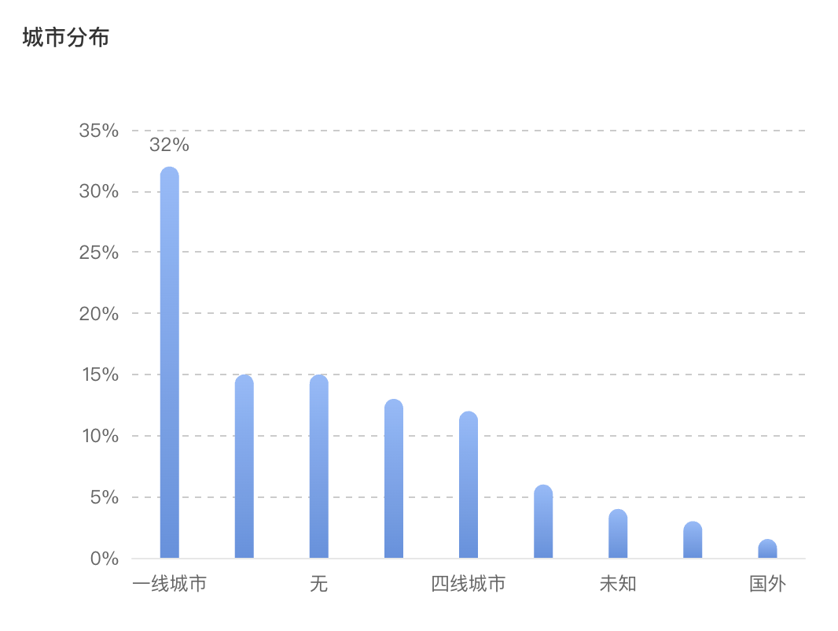
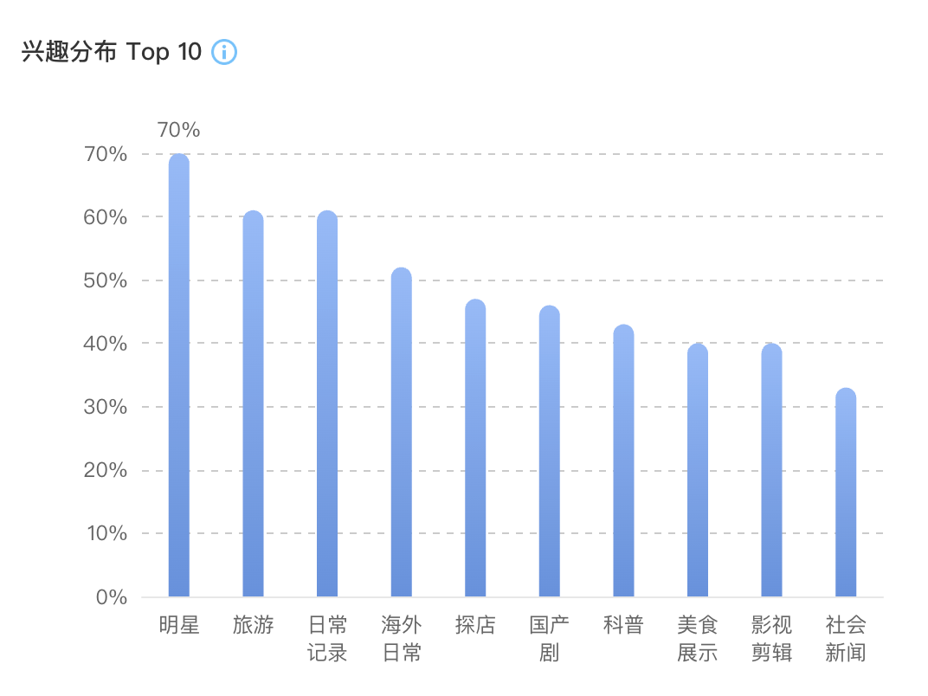
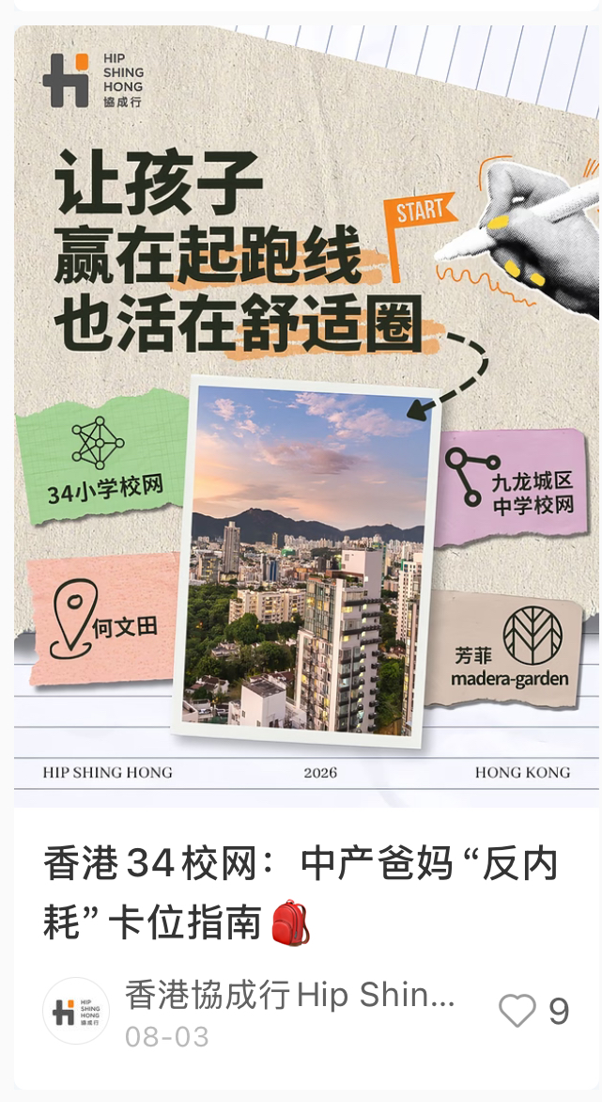
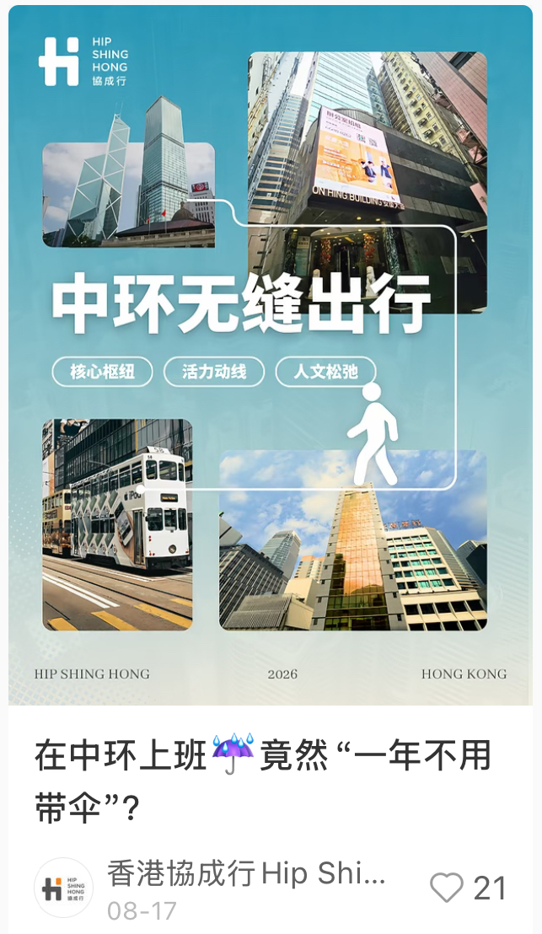
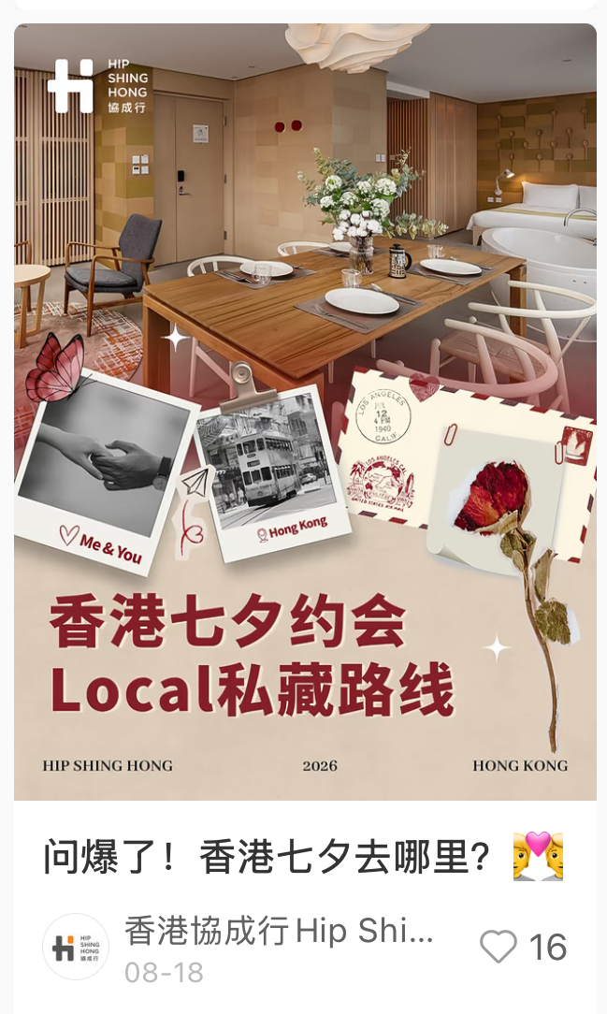
Account Summary
Data overview
Fans feature
Page level statistics | Aug 2026
Fans Number | 2,253
Net Fans Growth | 106
Engagement | 73
Views | 335
Impressions | 6701
Post no. | 3
58.2% followers are female, 22% aged between 41-50, 32% located in first-tier cities.
Our posts are mostly found by users on 1st page recommendations and search page.
This month, we published 3 posts and gained 46 likes.

Slide 3
XHS Post Performance Analysis
The post of “在中环上班☔竟然“一年不用带伞”？” achieved the highest engagement of 30, alongside 141 views.
“问爆了！香港七夕去哪里？💑” post followed with 25 engagements and the highest engagement rate of 27.47%.
XHS Post | Date of Publish | Subject | View | Like | Comment | Share | Saved | Total Engagement | Total Engagement Rate | Fans Increased
1 | 8月 3 | 香港34校网：中产爸妈“反内耗”卡位指南🎒 | 103 | 9 | 3 | 1 | 5 | 18 | 17.48% | 1
2 | 8月 17 | 在中环上班☔竟然“一年不用带伞”？ | 141 | 21 | 1 | 1 | 7 | 30 | 21.28% | 0
3 | 8月 20 | 问爆了！香港七夕去哪里？💑 | 91 | 16 | 1 | 1 | 7 | 25 | 27.47% | 1
Aug total |  |  | 335 | 46 | 5 | 3 | 19 | 73 | 21.79% | 2

Slide 4
Aug. Media-buy Performance - Post Boosting
聚光
The education-themed post “香港34校网：中产爸妈“反内耗”卡位指南🎒” achieved the highest engagement (12) and lowest CPC (3.98 RMB).
The Qixi festival post “问爆了！香港七夕去哪里？💑” followed with 7 engagements. Overall August CPC averaged at 4.01 RMB.
XHS Subject | Period | Objectives | Cost￥ | Impressions | Clicks | Likes | Comment | Saved | Follow | Share | Total Engagement | CTR | CPC ¥ | CPM ¥
香港34校网：中产爸妈“反内耗”卡位指南🎒 | 8/3-8/5 | 全站智投-互动量 | 95.43 | 827 | 24 | 10 | 0 | 2 | 0 | 0 | 12 | 2.90% | 3.98 | 115.39
问爆了！香港七夕去哪里？💑 | 8/18-8/20 | 全站智投-互动量 | 60.96 | 549 | 15 | 6 | 0 | 0 | 1 | 0 | 7 | 2.73% | 4.06 | 111.04
在中环上班☔竟然“一年不用带伞”？ | / | / | / | / | / | / | / | / | / | / | / | / | / | /
Aug Total |  |  | 156.39 | 1,376 | 39 | 16 | 0 | 2 | 1 | 0 | 19 | 2.83% | 4.01 | 113.66
HKD Total + 20% Service fee |  |  | $217.69
Exchange rate: 1RMB = 1.16 HKD

Slide 5
July. Media-buy Performance - Page Boosting
Exchange rate: 1RMB = 1.16 HKD
薯条
In August, we continued utilizing XHS Boost (薯条) to drive post likes and saves. The post “在中环上班☔️竟然‘一年不用带伞’?” achieved
the highest CTR of 5.27% and the lowest CPC of 3.26 RMB.
The overall campaign generated 3,351 impressions and 115 clicks at a total cost of 550 RMB (HKD $765.60 incl. service fee).
XHS Subject | Period | Objectives | Cost￥ | Impressions | Clicks | Likes | Comment | Saved | Follow | Homepage Views | Direct Messages | CTR | CPC ¥ | CPM ¥
在中环上班☔竟然“一年不用带伞”？ | 8/17 | 点赞收藏量 | 150 | 873 | 46 | 9 | 0 | 2 | 0 | 3 | 0 | 5.27% | 3.26 | 171.82
在中环上班☔竟然“一年不用带伞”？ | 8/17 | 点赞收藏量 | 200 | 1,296 | 38 | 6 | 0 | 2 | 0 | 2 | 0 | 2.93% | 5.26 | 154.32
问爆了！香港七夕去哪里？💑 | 8/18 | 点赞收藏量 | 200 | 1,182 | 31 | 5 | 0 | 3 | 0 | 0 | 0 | 2.62% | 6.45 | 169.20
Aug Total |  |  | 550 | 3,351 | 115 | 20 | 0 | 7 | 0 | 5 | 0 | 3.43% | 4.78 | 164.13
HKD Total + 20% Service fee |  |  | $765.60

Slide 6
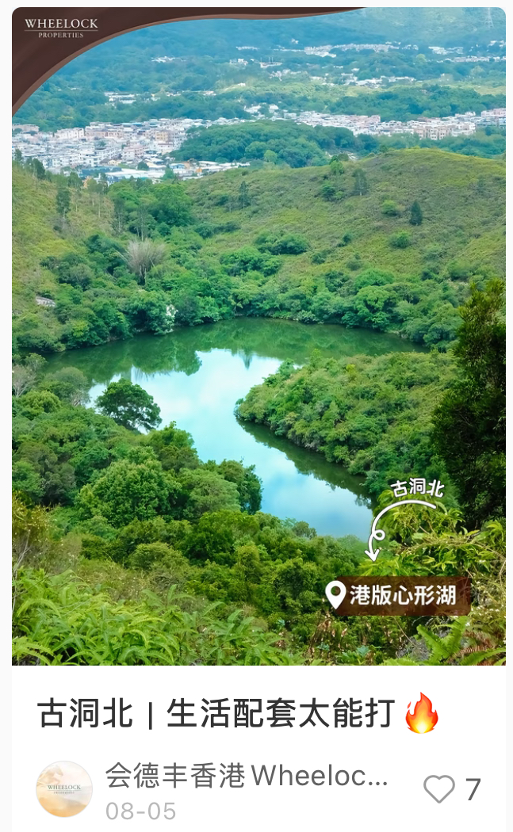
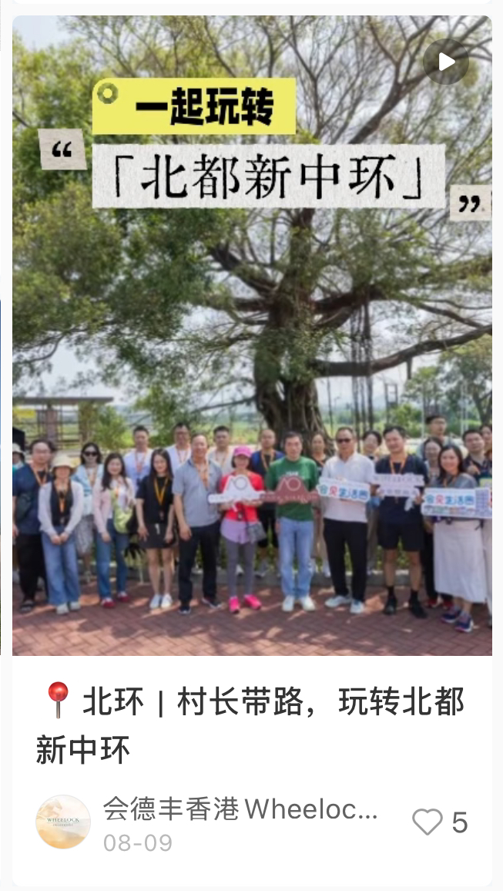
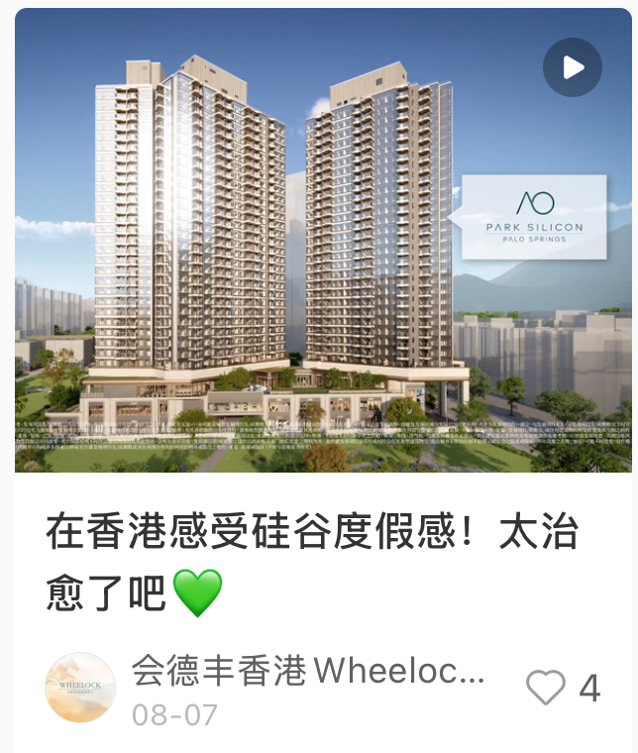
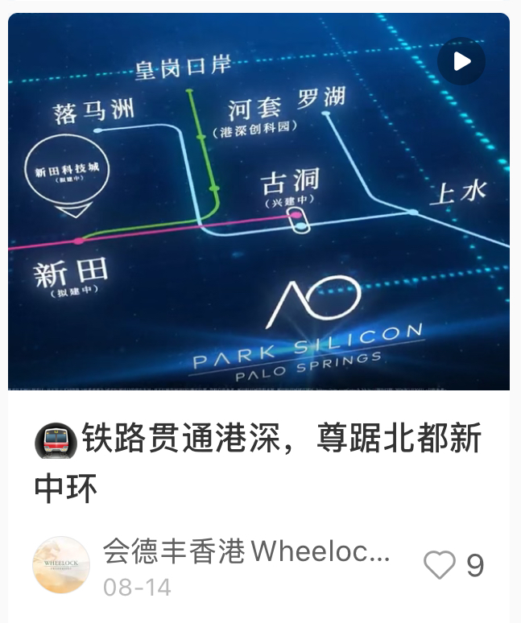
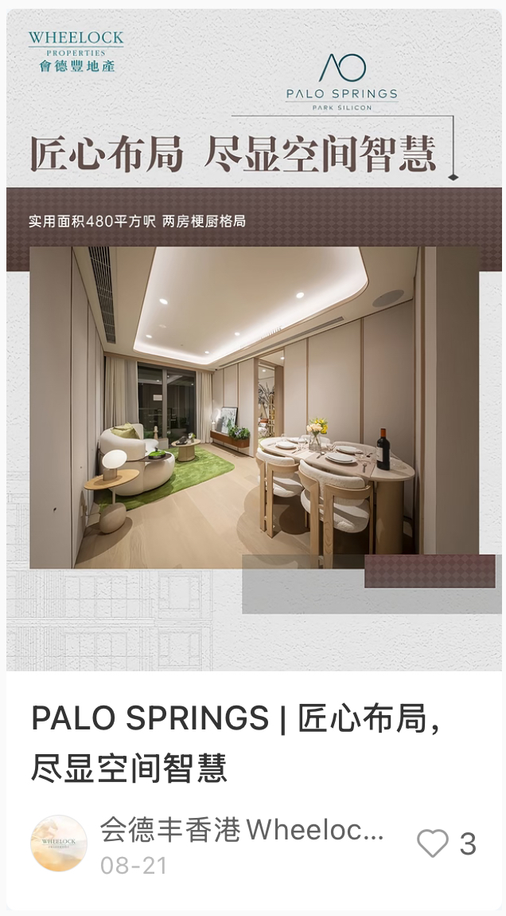
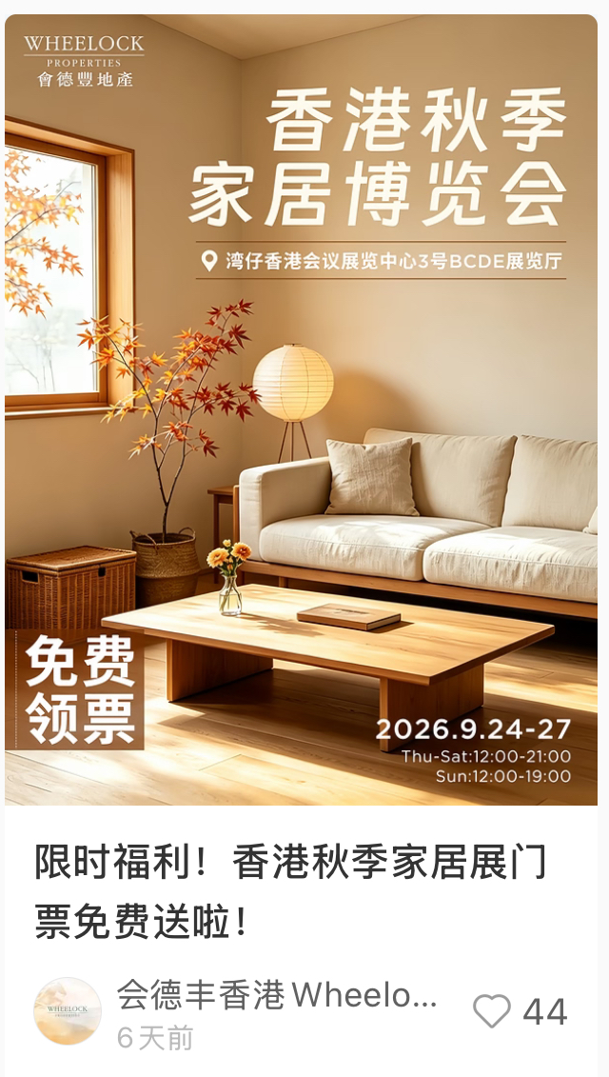
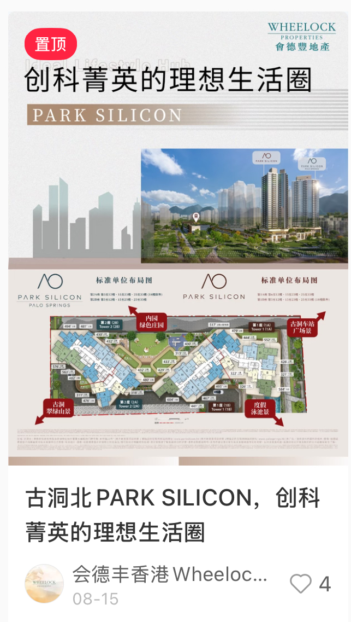
Competitors Analysis
会德丰香港WheelockLiving
Account overview in Aug. :
Total posted 7 feeds, including 4 text and 3 video feeds
Content Pillar：Experiential Living & Local Engagement & Offers
Top1 post analysis-限时福利！香港秋季家居展门票免费送啦！
The post performs exceptionally well by leveraging the "2026 Autumn Home Expo" and a free ticket giveaway — featuring 600+ booths, 7 themed zones, and the debut of "InZpire Luxe" luxury furniture exhibition with international masterpieces — which effectively captures user attention among homebuyers and renovation enthusiasts, keeping the brand top-of-mind in a practical and festive manner.
Aug Top 2&3 content:
“🚇铁路贯通港深，尊踞北都新中环” The post performs well by recasting Kwu Tung North as the "New Central of the North Metropolis", leveraging MTR and port connectivity to attract cross-border commuters and drive interest in PALO SPRINGS.
“古洞北PARK SILICON，创科菁英的理想生活圈” The post performs well by recasting PARK SILICON as a "Silicon Valley-style" resort, leveraging its prime location near I&T hubs to attract tech professionals and drive project interest.

Slide 7
Learning & Suggestions
Competitors Benchmarking：
Key takeaways from Wheelock Living (Aug):
(1) Giveaway-driven engagement​ — ticket giveaways (Home Expo, Cat Expo, concert) remain their most reliable traffic formula;
(2) Area storytelling​ — recasting Kwu Tung North as "North Metropolis New Central" to build regional premium;
(3) Cross-platform matrix​ — leveraging KOLs + mainland channels to reach buyers.

Slide 8
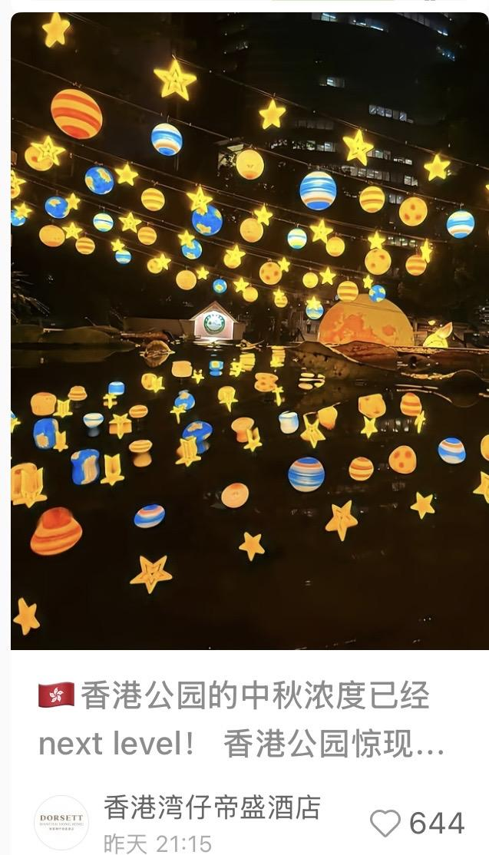

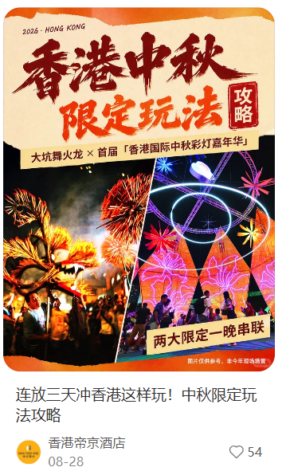
Learning & Suggestions
Content Strategy Recommendations:
Mid-Autumn & National Day Seasonal Scenario Marketing Strategy
Capitalize on the September–October travel peak (Mid-Autumn Festival and National Day). Instead of traditional, hard-sell property promotions, shift to a highly interactive hook (e.g., local cultural trivia) to spark curiosity and discussion among tourists. This seamlessly transitions into the desire for a "relaxed" holiday, allowing for a soft and natural integration of Hip Shing Hong’s hotel portfolios, thereby boosting readability and brand affinity.
e.g. Promote Hotel Madera using a fun cultural trivia hook (e.g., why Hong Kong's Mid-Autumn holiday falls the day after) to pitch a slow-paced, relaxing vacation that naturally showcases the hotels as ideal bases for authentic local exploration.

Slide 9
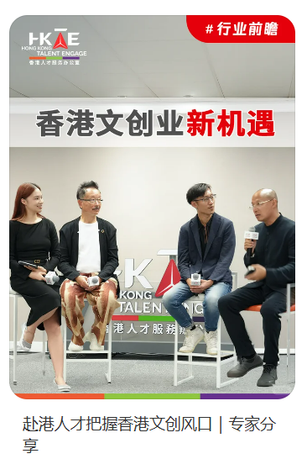
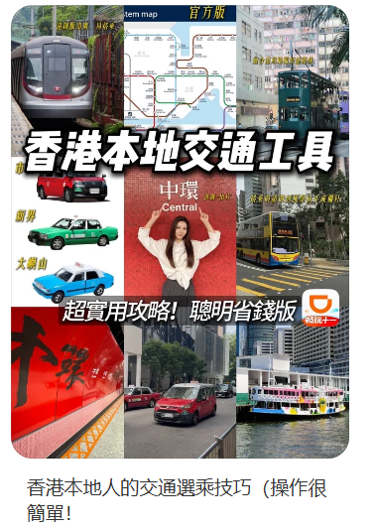

Learning & Suggestions
Content Strategy Recommendations:
Focus on Topics Users Truly Care About
Transform policy and market trends—such as talent inflow and GBA entrepreneurship—into life and work topics that urbanites truly care about. Start from down-to-earth scenarios like commuting, pet-friendly living, and the startup ecosystem, and naturally highlight the differentiated strengths of Hip Shing Hong’s projects, making brand content more aligned with users’ real needs.
e.g. Content can revolve around Hong Kong’s new regulations, local lifestyle, and vertical startup topics—introducing Genesis through pet-friendly living, highlighting Office Plus’s “just steps from the MTR” convenience via commuting pain points, and showcasing Gravity’s flexible working model for startups. This conveys brand value through relatable, real-life scenarios for sustainable long-term content output.

Slide 10
Thank You
Contact: info@dichat.hk

